Slide 1


Program Query Language - PQL
March 22, 2021
Peter Samouelian
Partha Pal, Brandan Kalashian
03/23/15

Slide 2
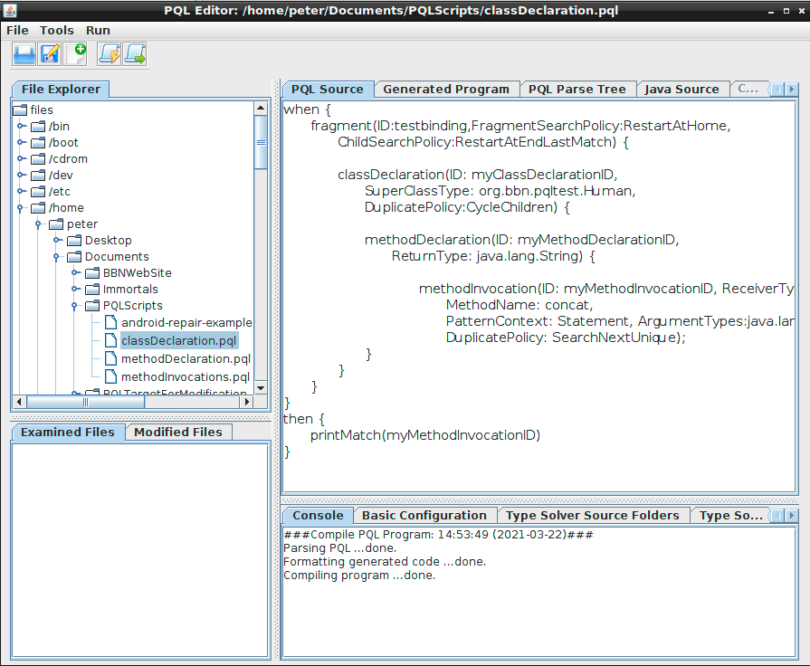
Agenda
Program Query Language (PQL)
Roots & Purpose
API Refactoring Types
Mitigation Approaches
PQL Approach
Technical Challenges
Demo
Future Vision
PQL IDE

Slide 3
PQL – Roots & Purpose
PQL owes its creation to the DARPA BRASS program as one approach to mitigate the code maintenance impact of API evolution.
API evolution
Changes to library/framework APIs that break client applications.
Over 80% due to semantic-preserving refactoring [1].
Purpose of PQL is to reduce the cost of impact analysis and maintenance on library/framework clients due to refactoring.
Common types of refactoring
that break client code [1]

Slide 4
Refactoring Types
Class A
Class A
Method A1
Method A1
Renaming or deleting methods.
Migrating methods to different classes (within or outside the original class hierarchy).
Moving class fields.
Method signature or return type changes.
Usage pattern changes.
Component clients interact with APIs using sequences of method calls on multiple classes (protocols) [2].
Class level changes (splitting code for improved cohesion).
Push Down
Pull Up
Class A’
Class A’
Method A1
Method A1
Class A
Class A
Method
Rename
Method A1
Method A2
Class A
Class A
Method A1
Method A1(int option)
Signature Change

Slide 5
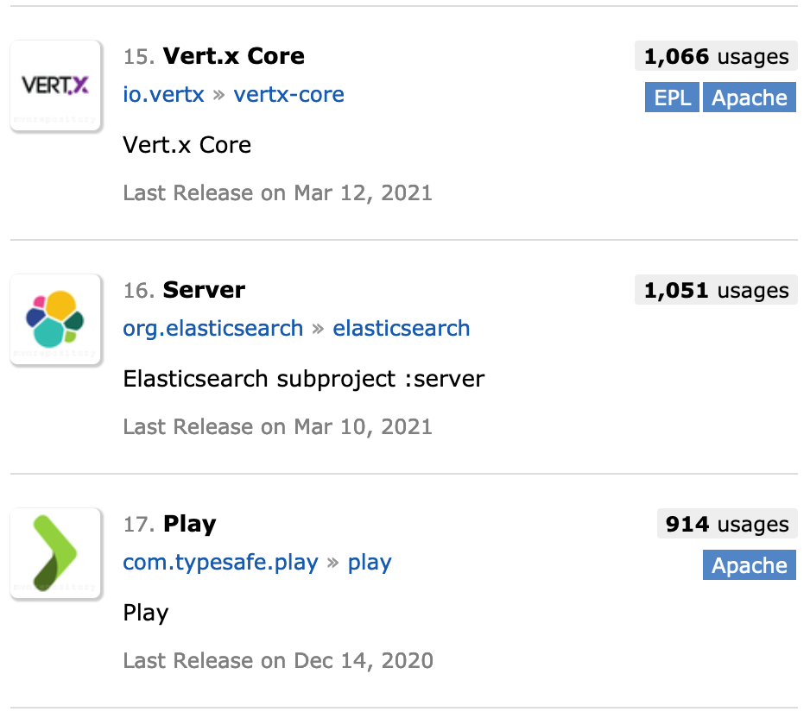
Impact On Client Code
While library developers can refactor their code efficiently, the cost of detecting and fixing client code that is impacted by the changes is significant.
Moreover, the burden is repeated across the industry for each library client.
Example: The Jackson Core library we used to evaluate our machine learning approach to API evolution.
Sample of clients that use Jackson-Core JSON Library
impacted by breaking API changes [3]

Slide 6
Mitigation Approaches
The Raytheon BBN-led IMMoRTALS project investigated 3 approaches to address the problem of API evolution:
Protocol Specifications
Machine Learning
Program Query Language (PQL)

Slide 7
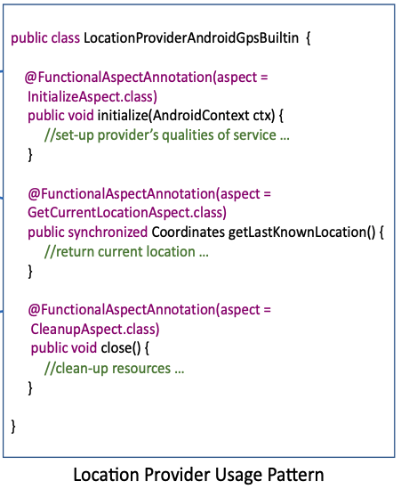
Mitigation Approaches
Protocol Specification
If protocols or usage patterns were captured by developers, the impact of their changes can potentially be reduced.
Example: An Android-based location provider exhibits a typical init-use-close pattern.

Slide 8
Mitigation Approaches
Protocol Specification
While this approach is promising, it presents two significant technical challenges.
The presence of usage-pattern metadata does not provide information on how that usage-pattern should be mapped to a call site.
Simply providing revisions to a usage pattern is insufficient: A mapping is often required between usage pattern versions in order to transform usage pattern instances.

Slide 9
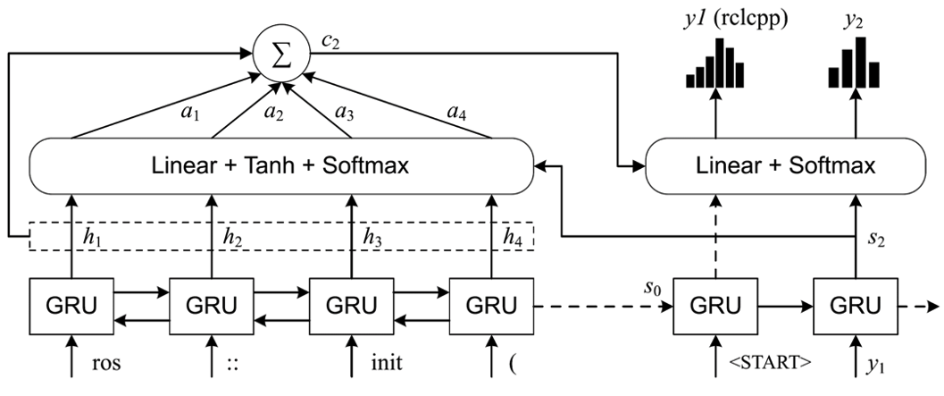
Mitigation Approaches
Machine Learning
Use sequence-to-sequence machine learning frameworks, like OpenNMT, to train artificial neural networks to detect and repair client code automatically.
LSTM Model Applied to ROS 1-to-ROS 2 Migration

Slide 10
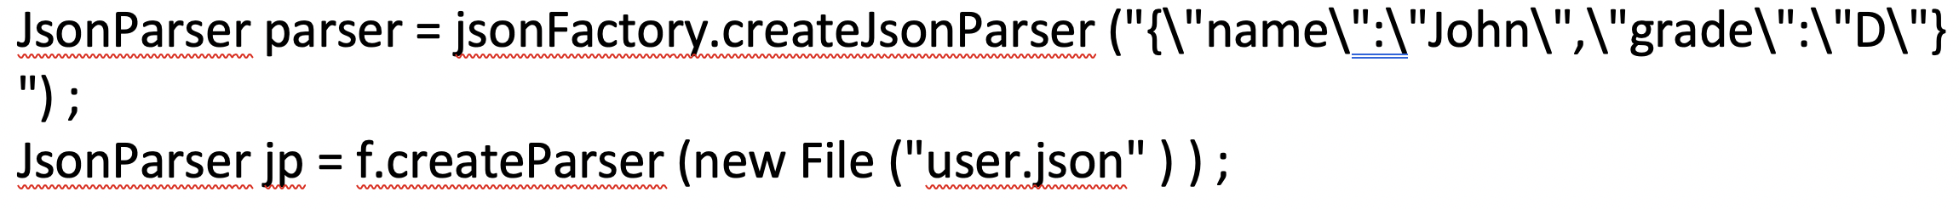
Mitigation Approaches
Machine Learning
This approach is also promising but faced with significant challenges:
Corpus of curated training data is required. Finding before-after samples that are relevant seems to pre-suppose a solution to the problem!
The neural network model cannot distinguish the important aspects of code migrations from incidental details, like variable names.
The salient aspects of the sample code migration above includes return types, object/class receiver types and argument types. Variables names, literals and expressions are not relevant.

Slide 11
Mitigation Approaches
Program Query Language
A robust and easy-to-use means to query and transform code, together with a delivery mechanism integrated with existing build tools (Maven central repository and plugins), would significantly address the burden of API evolution across industry.

Slide 12
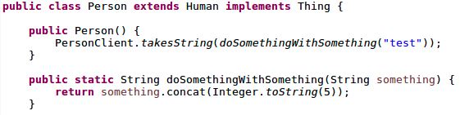
PQL - Technical Challenges
A toolkit that mitigates the impact of API evolution must provide an easy-to-use means to query and transform source code.
Code queries may need to consider hierarchy.
Ex: “Find uses of String.concat occurring in methods that have the doSomethingWithSomething signature and only in classes that extend Human.”

Slide 13
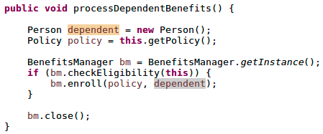
PQL - Technical Challenges
Code queries may require partial or full orderings.
Ex: “Find instances where variables of Person and Policy are declared (in either order) and where the BenefitsManager usage pattern below occurs (in the specified order).”
Don’t care about order
Care about order
(specific usage
Pattern)
Order of potential query matches may or may not matter depending on the API evolution being mitigated.

Slide 14
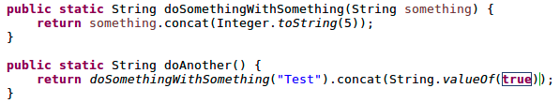
PQL - Technical Challenges
Query patterns must resolve types to match patterns correctly.
Ex: “Find invocations of String.concat(String value)”
Correctly detecting the above matches for the given query requires resolving symbols and expressions to their language types.

Slide 15
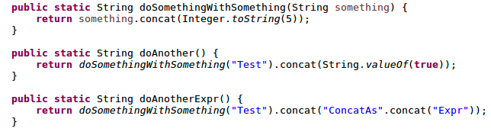
PQL - Technical Challenges
Query patterns must consider context.
Ex: “Find invocations of String.concat occuring in the context of statements (vs. expressions).”
Queries may need to consider context since they may apply
different transformations for statements vs. expressions.

Slide 16
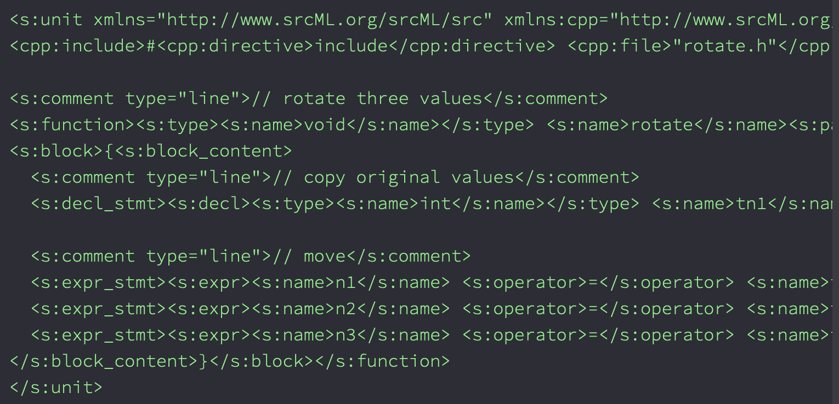
PQL - Technical Challenges
The query and transformation language must be easy-to-use and enable lexically preserving code transformations.
Projects like srcML represent parse trees as XML and defer code querying and transformation tasks to XML libraries, like XSLT, XPath and XQuery.
Queries and transformations require complex, messy XSLT, XPath and XQuery.
srcML XML Representation of Code [4]

Slide 17
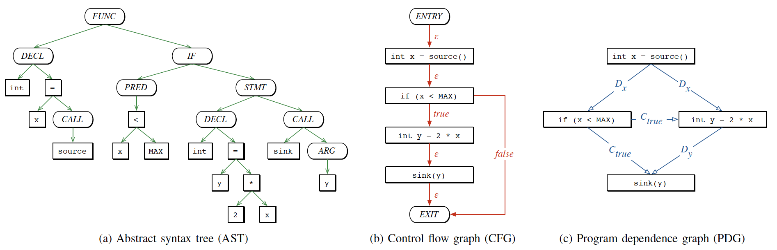
PQL - Technical Challenges
Code Property Graphs provide an abstracted representation of code that may be easier to query but this abstraction does not support code transformations.
Code Property Graphs incorporate abstract representations [5]

Slide 18
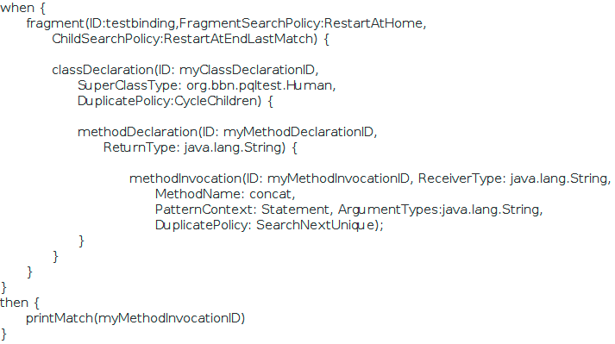
PQL Design
PQL addresses each of these challenges by providing a DSL, IDE and compilation toolchain that supports hierarchical queries that can check for partial orderings and code context, as well as resolve all symbols and expressions to types.
PQL uses a high-fidelity parse-tree representation of code tailored to Java and capable of enabling format-preserving code transformations.
PQL Sample
Ex: “Find uses of String.concat in methods that return Strings defined in classes that extend the Human supertype.”

Slide 19
PQL Design
PQL provides an ANTLR-based grammar that supports a Domain Specific Language (DSL) tailored for querying and transforming code.
when {
fragment(options) { //Options control matching policy
details (e.g., partial orderings)
codePattern(options) {} //Patterns match code artifacts
and bind names to them
codePattern(options) {}
fragment(options) {} //Fragments can be nested to
create powerful queries
}
} then {
command(options) {} //Commands act on name bindings to
modify/create/delete code artifacts
command(options) {}
}
General PQL Structure

Slide 20
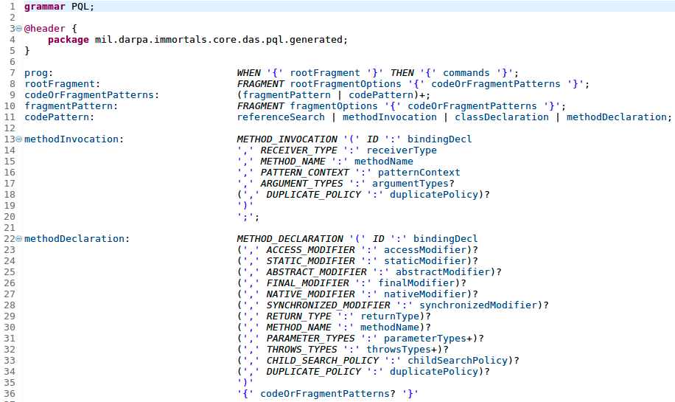
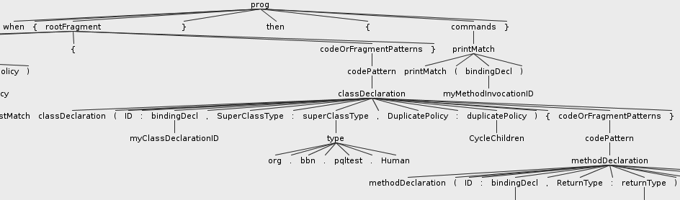
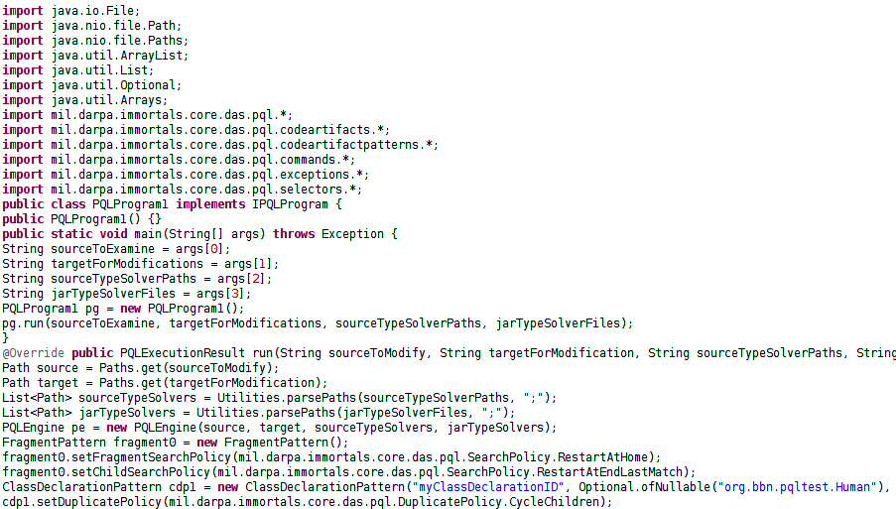
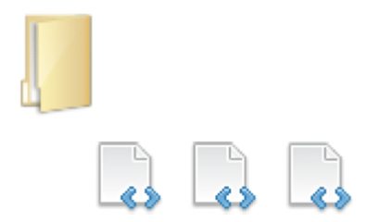
PQL Toolchain
+
The PQL toolchain creates a parse-tree of the source PQL.
Then it generates and compiles Java source code dynamically.
This results in a distributable program that queries and transforms source code for a given API migration case.
These programs can be packaged with libraries along with their API changes using Maven central and Maven plug-ins (future work).
parse
PQL Source
PQL Grammar
generate
PQL Parse Tree
compile
run on
Java Source
Java Program
Target Source

Slide 21
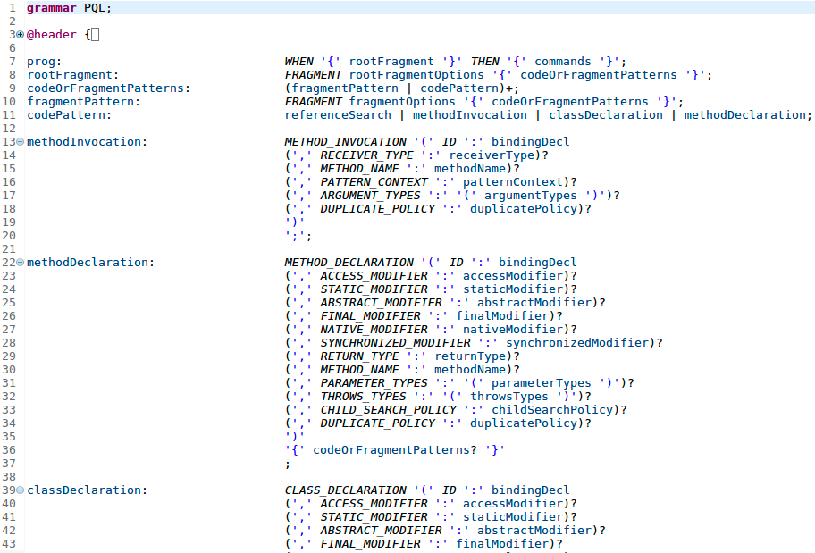
PQL Grammar
PQL’s DSL grammar is similar to Java itself and makes it easy to identify and transform code artifacts.
Sample of PQL’s DSL grammar

Slide 22
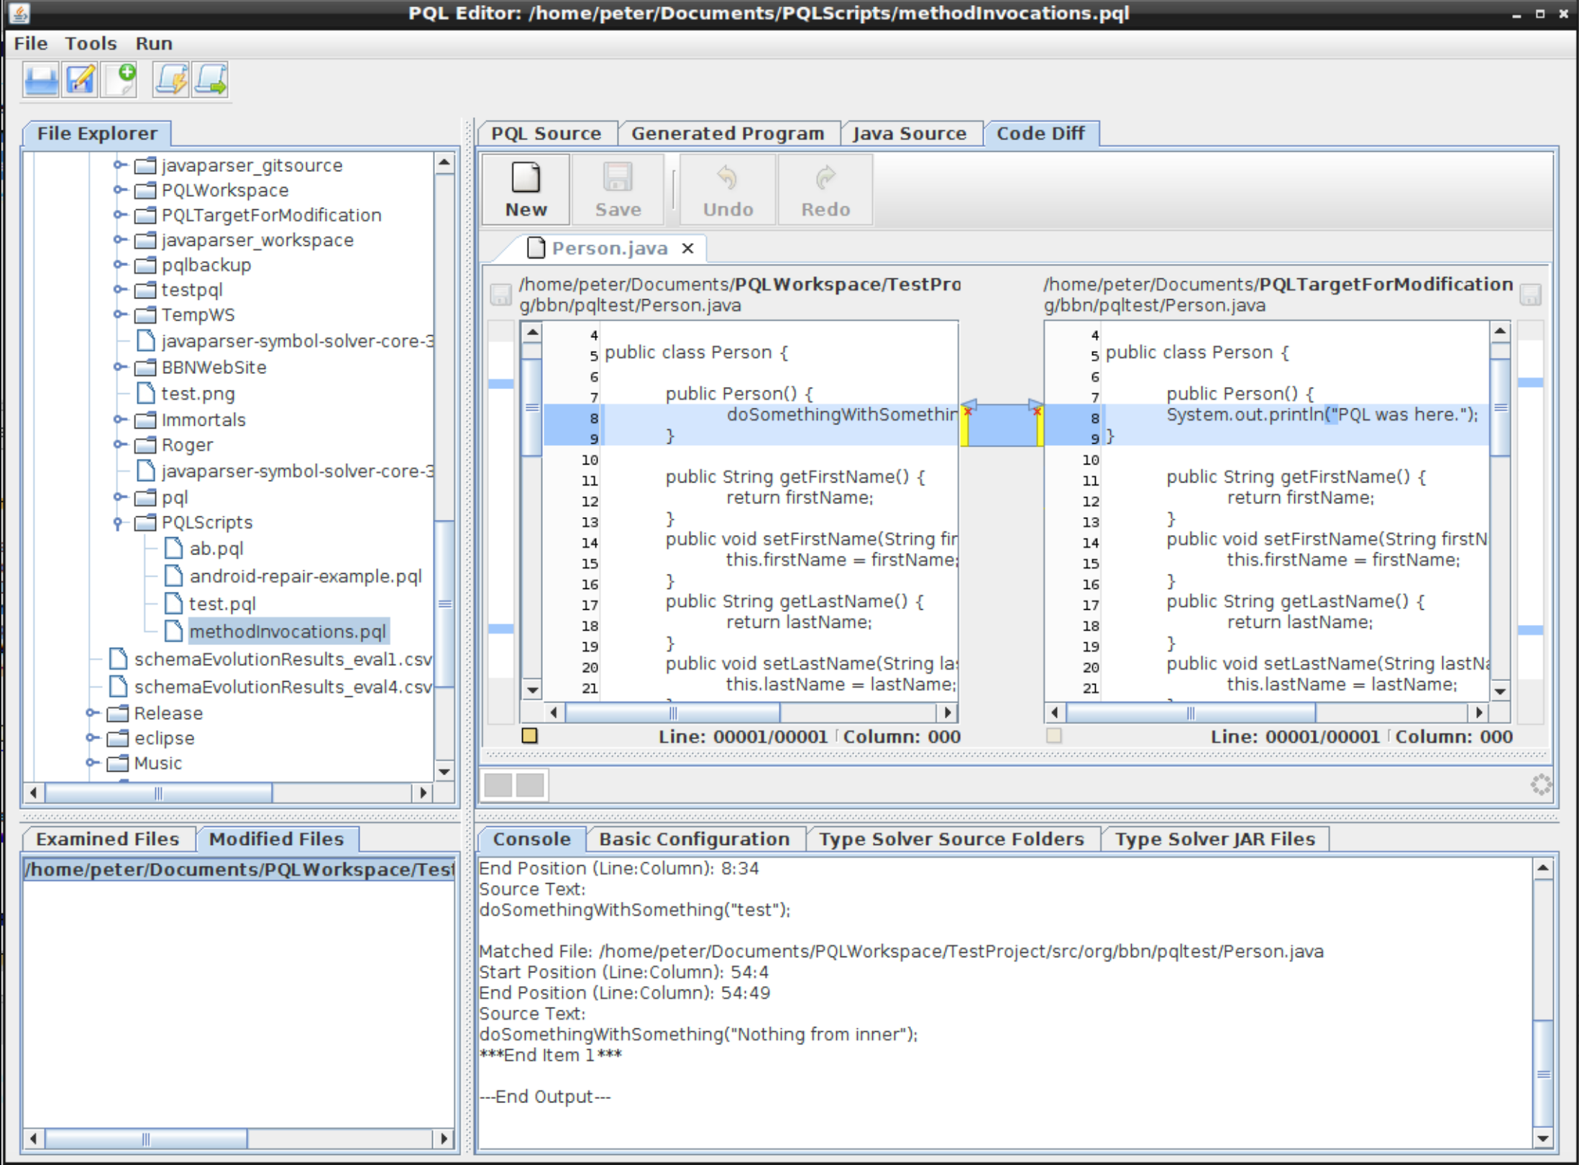
PQL IDE
PQL’s IDE makes it easy to review and approve the changes PQL makes to source code.
A before-after code diff is shown in the IDE’s center view.
Users may approve or reject changes individually or as a whole.
A summary of examined and modified files is shown in the lower half.
PQL IDE (Code Diff and Change Review)

Slide 23
ROGER Transition Case
ROGER is a server application framework and implementation used by government agencies (DoD, IC and SAR communities).
ROGER uses plugins to provide various services. Each plugin’s lifecycle stage, including initialization, is managed by the core ROGER server.
Developers noted that providing the plugin with a name during initialization would significantly assist with troubleshooting.
It turned out that the changes required multiple touchpoints that were well defined but time consuming to implement manually.

Slide 24
ROGER Transition Case
I went to graduate school for this?
The changes requires the following steps:
Examine 176 Java sources files for those that implemented the PlugIn Java interface or one of its descendants.
Modify the identified files by:
Adding a String parameter to the Configure method.
Adding a class field to hold the value.
Adding a getter and setter method to the file.
Adding a method invocation in the Configure method to invoke the setter.

Slide 25

ROGER Transition Case
I GOT THIS!
when {
fragment(options) {
codePattern(options) {}
}
} then {
command(options) {}
}
PQL
PQL Knows How To …
Match Code Patterns
Modify Code Patterns

Slide 26
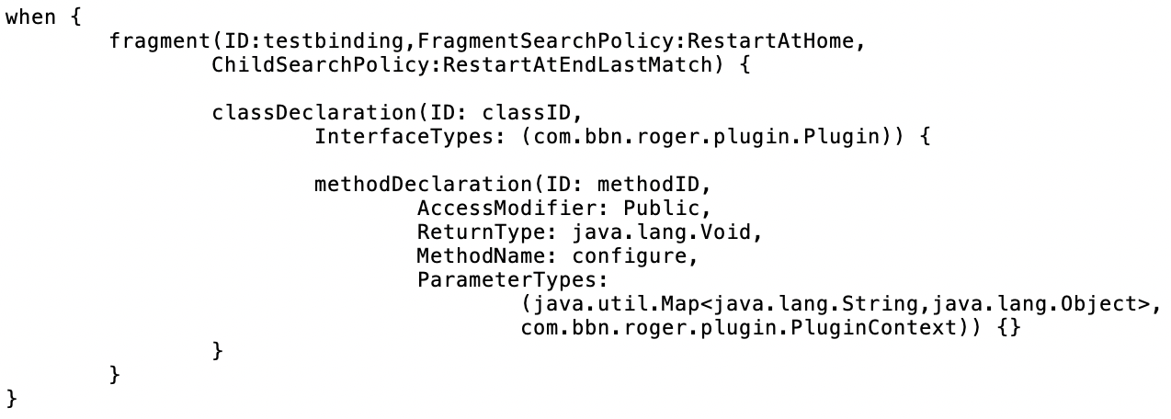
PQL Syntax
Find classes that look like this …
… for method declarations that look like this.
Oh yeah, and it give each result an ID I can reference to change the code (e.g., methodID and classID)
PQL Pattern Language To Describe What to Look For

Slide 27
PQL Syntax
Add Parameter to methodID
Add Getter & Setter to classID
… you get the picture
PQL Pattern Language To Describe What to Change and How To Change It

Slide 28
ROGER Transition Case - Results
176 Java Classes Examined
Matches found in 80 files
78 files modified
34 kloc analyzed
Runtime < 9 seconds (first time)
Runtime < 5 seconds (subsequent runs after caching parse trees)
Multi-threaded parse-tree generation
Run on Ubuntu 16.04 LTS Virtual Machine with 4 CPU, 8 GB Ram.
Results preserve all lexical information (comments and whitespace) – friendly for future-maintainence!

Slide 29
PQL Expressivity
PQL is tailored to lowering the cost of API evolution on clients. The focus is on Java and object-oriented programming.
PQL’s expressivity includes matching typical object-oriented constructs, like method declarations and invocations, field declarations, getter/setter declarations and invocations, constructor declarations, variable references, class declarations, exception declarations, etc.
Using these constructs, PQL can detect many kinds of complex multi-line API protocol changes, as well as simple method signature changes.

Slide 30
Demo

Slide 31
References
[1] D. Dig and R. Johnson, “How do APIs evolve? A story of refactoring,” p. 26, 2006.
[2] Y. Cheon and A. Perumandla, “Specifying and checking method call sequences of Java programs,” Software Quality Journal, vol. 15, no. 1, pp. 7–25, Jan. 2007, doi: 10.1007/s11219-006-9001-4.
[3] “Maven Repository: com.fasterxml.jackson.core » jackson-core (Usages).” https://mvnrepository.com/artifact/com.fasterxml.jackson.core/jackson-core/usages?p=2 (accessed Mar. 23, 2021).
[4] “Creating srcML.” https://www.srcml.org/tutorials/creating-srcml.html (accessed Mar. 23, 2021).
[5] F. Yamaguchi, N. Golde, D. Arp, and K. Rieck, “Modeling and Discovering Vulnerabilities with Code Property Graphs,” in 2014 IEEE Symposium on Security and Privacy, San Jose, CA, May 2014, pp. 590–604, doi: 10.1109/SP.2014.44.

